Slide 1
Observations on Fusion Power Market Attractiveness
Ryan Umstattd
Director, Tech-to-Market

Slide 2
The electricity market is a competitive place
Signed power purchase agreements exist at or below $0.035/kWh (PV) and $0.02/kWh (Wind)
…but challenges remain for PV or Wind to serve as a merchant generator
https://www.energy.gov/eere/downloads/revolutionnow-2016-update

Slide 3
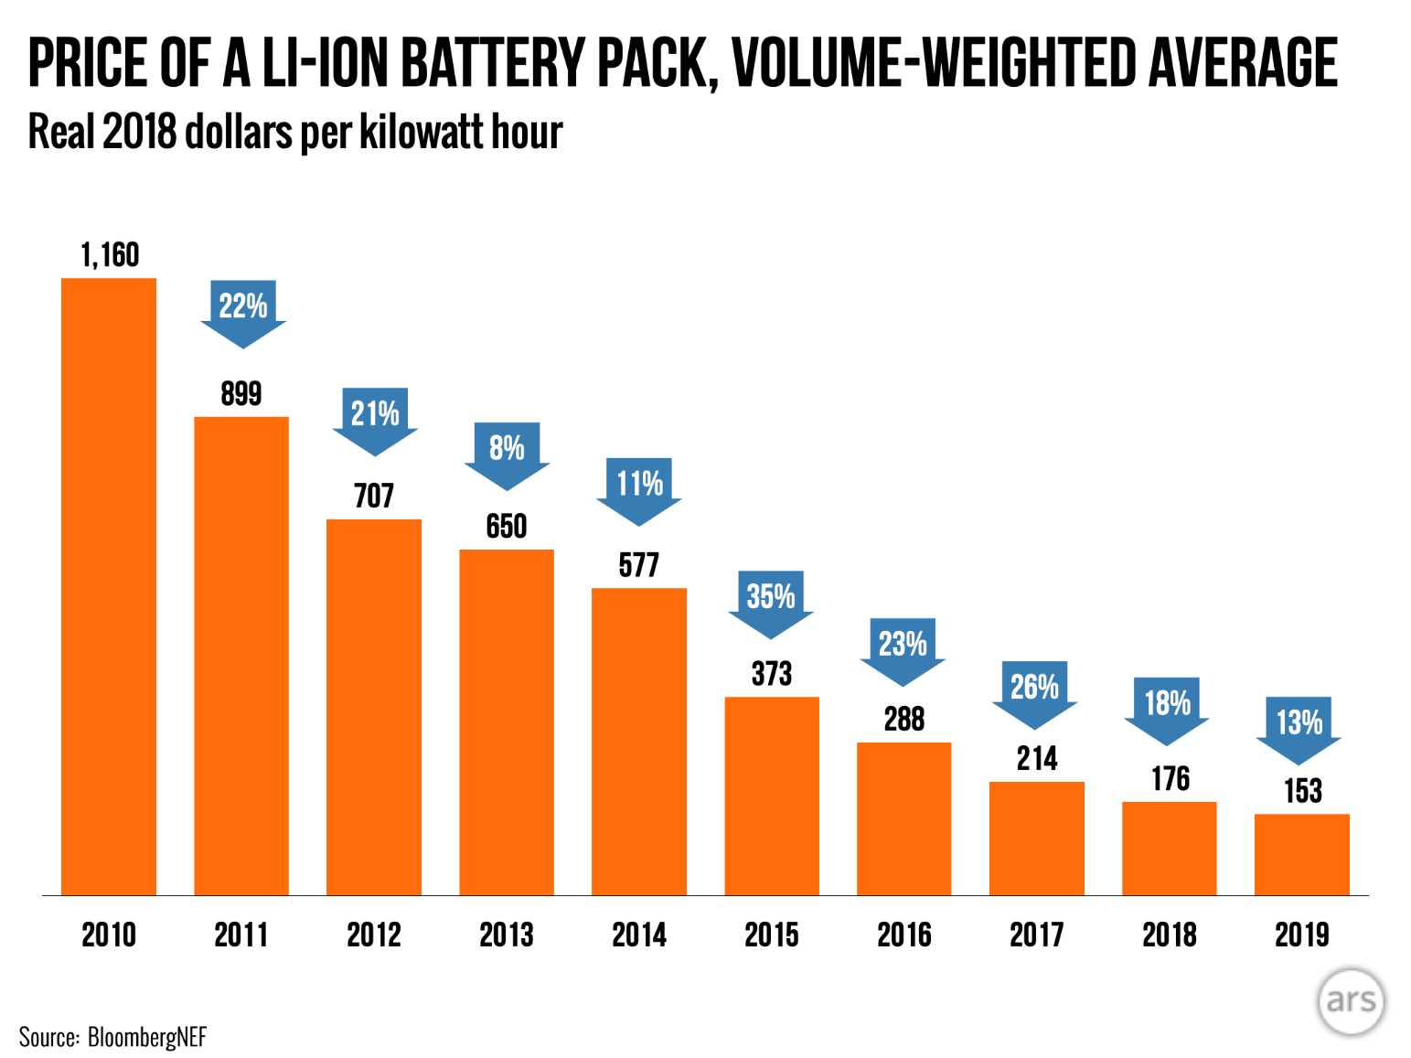
But intermittent renewables are no panacea
Fusion-specific benefits:
  power density and geographic / seasonal independence
…but can fusion deliver re: cost and load-following?
Budischak, et al

Slide 4
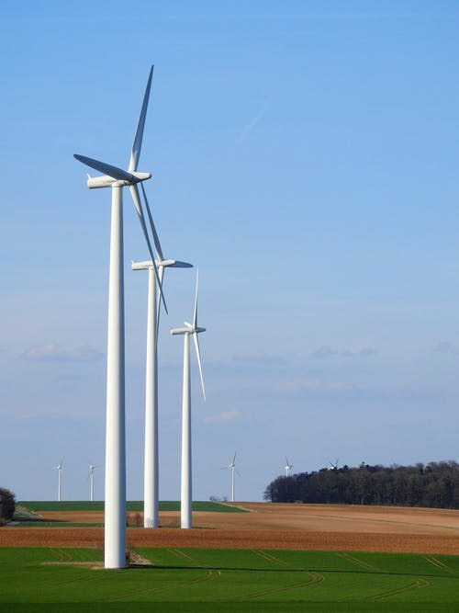
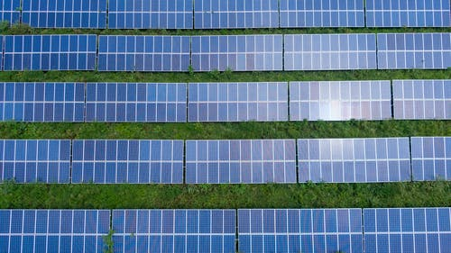

Power plant footprints
Wind:
71 Acres / MW
Mumbai or Tokyo electricity demand: 1 MW / 60 acres
Solar:
44 Acres / MW
Fuel-based power plant:
13 Acres / MW
L. Stevens et al, “The footprint of energy: land use of U.S. electricity production,” Strata 2017

Slide 5
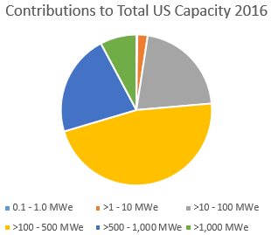
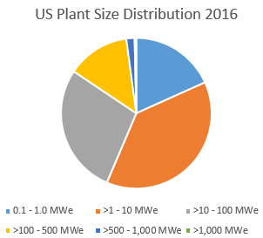
The scale of U.S. power plants today
In 2016, plants larger than 1 GWe were responsible for 8% of U.S. electricity generation capacity
Of the ~17,000 plants with > 1MWe capacity, only 76 are > 1 GWe
All data from Form EIA-860 -- https://www.eia.gov/electricity/data/eia860/

Slide 6
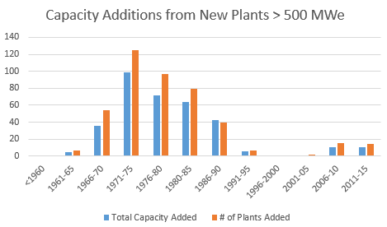
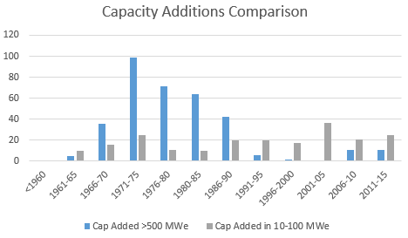
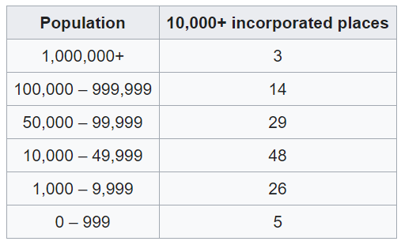
Evolution of the U.S. power plant fleet
All data from Form EIA-860 -- https://www.eia.gov/electricity/data/eia860/
# of high-density cities/towns
Large scale plants are the exception rather than the rule
Smaller plants offer greater flexibility in:
  financing options (to build)
  matching load changes (in operation)
1 GW-scale plant
100 MW-scale
10 MW-scale
https://en.wikipedia.org/wiki/List_of_United_States_cities_by_population_density

Slide 7
Things we’ve heard from utilities
Load-following capability and frequency support
Sized to match load growth
Lower capital cost capacity additions
More distributed / incremental
Smaller footprint
More siting options
Enhanced safety / security
Shorter construction timeline
Smaller operational staff

Slide 8
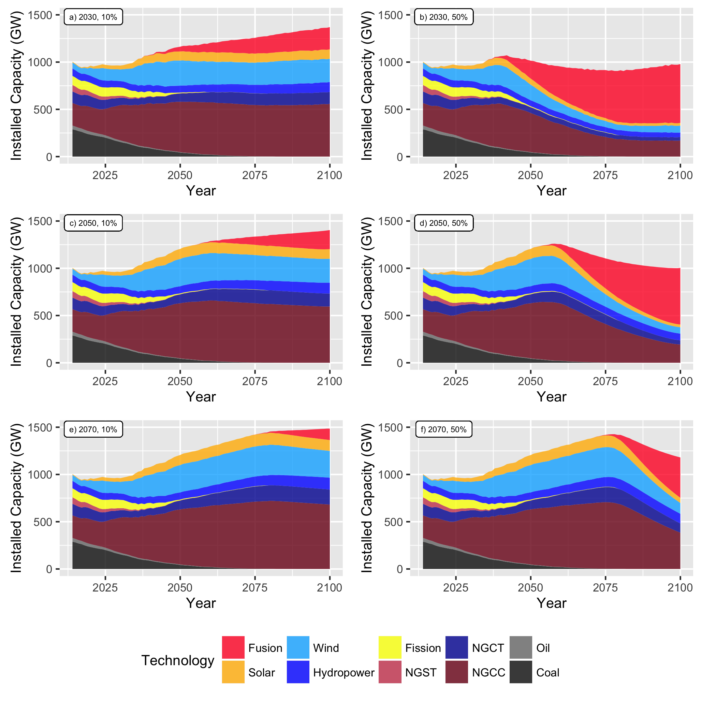
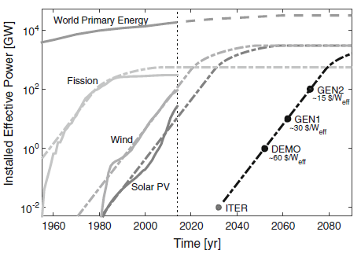
Fusion adoption scenarios
Key takeaways:
  Later fusion entry generally equates to larger initial fusion plant additions due to larger total electricity demand
  Depending on market share, fusion ramps up to approx. 3-15 GWe / yr capacity additions in U.S.
Cordozo, Lange, Kramer, JFE 2016
L. Spangher, J. S. Vitter and R. Umstattd, “Characterizing Fusion Market Entry via an Agent-based Power Plant Fleet Model,” Energy Strategy Reviews 26, 100404 (Nov 2019)

Slide 9
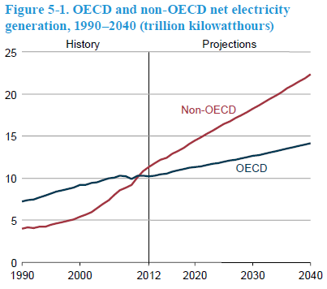
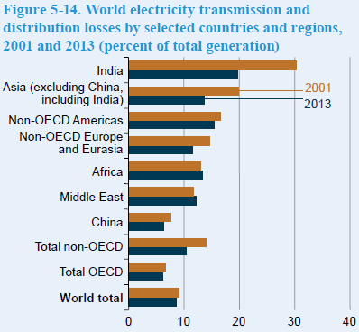
Opportunities overseas
Net electricity generation in non-OECD countries rises twice as fast as in the OECD
Transmission & distribution infrastructure still maturing in some markets
EIA International Energy Outlook 2016 -- DOE/EIA-0484(2016)

Slide 10
Getting there from here: can private financing support fusion development?
Attributes for matching investors with fusion development
  The investors: philanthropic, mission-oriented, patient (a small but growing subset of general venture capital) OR energy sector strategic / corporate venture
  The technology: development path needs well-defined stage gates
    Demonstrate step-changes in valuation during development
    Demonstrate quantified risk-reduction
Portfolio approach for both the investors and the technologies
  To manage technology risk, need diverse, independent approaches
  Need tiers of investors matched to each stage of tech risk / capital requirements
Opportunities for early revenue streams consistent with path to fusion energy

Slide 11


